Slide 1

Safe Sharing: Access Control for Cloud Stored Data
by
G. Ajay Kishore
Roll No. 204G1A0506
M. Mounika
Roll No. 204G1A0561
T. Harsha Sri
Roll No. 204G1A0536
B. Bhavana
Roll No. 204G1A0522
Under the guidance of
Mr. M. Narasimhulu M.Tech (Ph.D)
Assistant Professor
Assistant Professor
Department of Computer Science and Engineering
Srinivasa Ramanujan Institute of Technology
Autonomous
Rotarypuram Village, B K Samudram Mandal, Ananthapuramu – 515701.
2023-2024

Slide 2
Comments
Justify the Title
What are the algorithms you have used?
What is the purpose of using symmetric encryption?

Slide 3

Contents
Abstract
Introduction
Literature Survey
Existing System
Proposed System
Planning
Design
Implementation
Research Paper
References

Slide 4
Abstract
The rapid expansion of cloud environments has brought about a significant challenge to secure data storage. This is a critical consideration for every user when decided to move the data online. To address this challenge, various solutions have been proposed, with two prominent approaches being Searchable Symmetric Encryption and Attribute-Based Encryption. SSE offers protection against both external and internal threats. It allows for efficient search capabilities while maintaining the confidentiality of the data. In an SSE technique, all data is usually encrypted using a single key. The entire encrypted database would need to be downloaded and re-encrypted with a new key if a user was to be revoked. Conversely, though, ABE offers a more granular approach to access control by encrypting data based on attributes and policies. This means that different users or groups can be granted different levels of access to the data based on their attributes.
Keywords: Encryption, Cryptography, Access Control, Searchable Symmetric Encryption (SSE), Attribute-Based Encryption(ABE)

Slide 5
Introduction
Cloud computing has significantly impacted daily life, being used by both large corporations and regular internet users.
Maintaining the security of data in the cloud is challenging due to it being managed by third parties, leading to susceptibility to internal attacks.
Symmetric Searchable Encryption (SSE) enables local encryption before cloud storage, but lacks user revocation support, while Attribute-Based Encryption (ABE) offers fine-grained access control with potential efficiency challenges for large datasets.
Secure authentication and encryption techniques are vital to protect data in transit and at rest, reducing the risk of unauthorized access.
The goal is to establish a comprehensive access control solution that balances security with usability, enabling secure data sharing and collaboration in cloud environments while mitigating the risks associated with unauthorized access and data exposure.

Slide 6
Literature survey
A. Michalas and A. Bakas [1] presented a novel technique that enables data owners to link specific policies to specific areas of their cipher texts. The scheme is based on existing symmetric primitives. They combined an in-depth a security study that employs simulation-based methods and includes an experimental evaluation is conducted to showcase the effectiveness of our scheme, thereby demonstrating the precision of our methodology.
A. Sharma claims in J. Bethencourt [2] study that using a reliable server for data storage and access control is the only way to enforce such regulations. In their system, a party encrypting data create a policy for who can decrypt, and attributes are used to characterize a user's credentials. Consequently, techniques like role-based access control (RBAC) .

Slide 7
Literature survey
K. Lui and T. H. Yuen [3] tells that the primary objective of this study is to emphasize and give attention to an encryption scheme called efficient revocable Ciphertext-Policy Attribute-Based Encryption. This particular encryption scheme is designed to allow the revocation of access to encrypted data based on specific attributes associated with the intended recipient. This means that if a user's attributes change, they can be revoked access to the encrypted data, ensuring security and privacy. The scheme focuses on enhancing the efficiency of the revocation process, ensuring that it can be done in a timely and effective manner. By utilizing this encryption scheme, organizations and individuals can have more control over who can access their encrypted data, enhancing overall data security.
The study by R. Dowsley [4] shows how to create a hybrid encryption scheme that combines SSE and ABE while taking advantage of their respective benefits. Unlike many other methods, we build a revocation process that is based only on SGX's capability and is totally independent of the ABE scheme.

Slide 8
Literature survey
The concept of backward privacy for searchable encryption is examined for the first time in the study by R. Bost and B.Minaud [5]. Following the theoretical definitions of several flavours of backward privacy, we propose multiple strategies with varied efficiency trade-offs that achieve both forward and backward privacy. Importantly, our constructs depend on primitives like puncturable encryption schemes and limited pseudo-random functions.

Slide 9
Existing System
In the current system, cryptography techniques are utilized for data storage. This involves the utilization of cipher text to store the encrypted data. The encryption process involves the application of a single encryption technique. In ABE schemes, all files undergo encryption using a master public key. However, unlike traditional public key cryptosystems, the resulting ciphertext is restricted by a policy. In addition, each user possesses a unique secret key associated with their respective attributes, such as their id, age, organization, etc. Consequently, decryption of a file is feasible only if the user's attributes satisfy the policy linked to the ciphertext. Nonetheless, employing an asymmetric encryption scheme to encrypt large amounts of data proves to be relatively inefficient.
Disadvantages:
Using single encryption key only.
Data encryption using ABE only.

Slide 10
Proposed System
To resolve the issues in the previous system, We proposed the approach which is compatible with deployment models for private, communal, or hybrid clouds. The suggested framework consists of the sensitive data in the cloud is encrypted using a hybrid encryption approach. Before the data is transferred to the cloud, it will be encrypted with a public key. We have specific access that only specific individuals can access the cloud.
An authorized user has the ability to view and edit cloud data information. A user can extract a certain block of code using the SSE Algorithm and use it to decrypt a particular file. Not all users of the ABE Scheme will be able to access data; authentication will only be granted to specific users.

Slide 11
Proposed System
The objectives of this proposed system are
To provide the protection for user assets in cloud environments by using encryption algorithms such as Searchable Symmetric Encryption and Attribute-Based Encryption.
To ensure secure data storage in cloud environments by encrypting sensitive data using a hybrid encryption approach .
To enable users to register and securely access the cloud using their email address and password .
To allow users to upload files to the cloud and view or retrieve them using a specific term as a key .
To enable users to share files with others by using a keyword that matches the index number.
To provide a feature that allows users to see requests made by other users for their files and decide whether to accept or reject them.

Slide 12
Planning
Objective
The main objective of the project is to provide the protection for user data in cloud environments through the use of encryption algorithms such as Searchable Symmetric Encryption (SSE) and Attribute-Based Encryption (ABE).
Performance
C

Slide 13
Planning
Functional Requirements
Business Rules
Authentication
External Interfaces
Certification Requirements
Reporting Requirements
Non-Functional Requirements
Security
Reliability
Usability
Documentation

Slide 14
Planning
System Requirements:
Hardware Requirements:
RAM : 4GB (min)
Hard Disk : 500GB
Processor: I3/Intel Processor
Software Requirements:
Operating System : Windows 7/8/10
Application Server : Tomcat 7.0
Front End : HTML, JSP
Server side Script : Java Server Pages.
Database : My SQL 6.0
Database Connectivity : JDBC

Slide 15
Planning
Methodology
This project uses Agile methodology. In that we use scrum agile methodology.
Scrum is characterized by cycles or stages of development, known as sprints.
It has four stages: Planning, Implementation, Testing and review.
Advantages:
This Methodology has ability to change and adapt with and satisfy the changing needs in short term.
Requires less documentation.

Slide 16
Planning
User Modules:
Register : user can enter the details and he can register.
Login : user can login with his valid credentials. If user enter invalid credentials then it can be redirect into login page. If user enters valid credentials then it can be redirect into user home.
Upload : Here, User can Upload the files.
While uploading the file it can be store into encrypted format and generates searchable keywords.
View Files : The user view the uploaded files and share files to other users.
Search: user can search for a file based on keywords. If file has been found send request to file uploaded user .
View request : In this user view the request from other users for their file then user can accept/ Reject the request .

Slide 17
Planning
Status : The user view the file requested status, i.e. pending and Accepted.
Download : user can download the file if his request is accepted. Here Encryption file converted into decryption format (original File) can be Download.

Slide 18
Planning
Work Schedule
S.No | Development Stage | Duration
1. | Domain and Title | 1 week
2. | Literature Survey | 2 weeks
3. | Planning | 1 week
4. | Design | 1 week
5. | Requirements Gathering | 1 week
6. | Testing | 3 weeks
7. | Implementation | 4 weeks

Slide 19
Design - ER Diagram
The ER diagram was created to help grasp the entire scenario. It was used to conceive the phenomena, actions, and interactions between numerous entities, as well as to arrive at the precise requirements in a complete manner.

Slide 20
Design - Use Case Diagram

Slide 21
Design - Activity Diagram

Slide 22
Design - Sequence Diagram

Slide 23
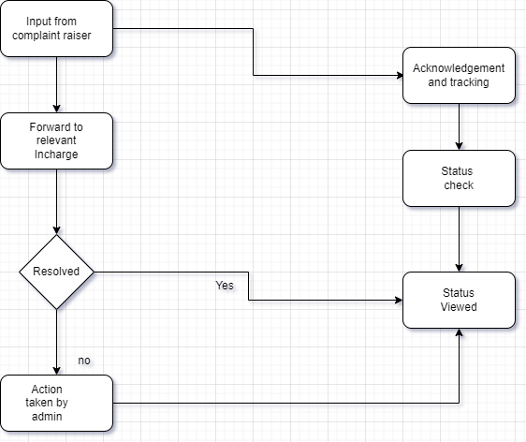
Design - System Architecture

Slide 24
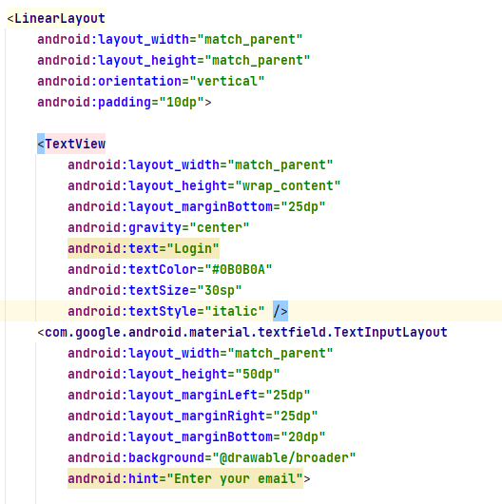
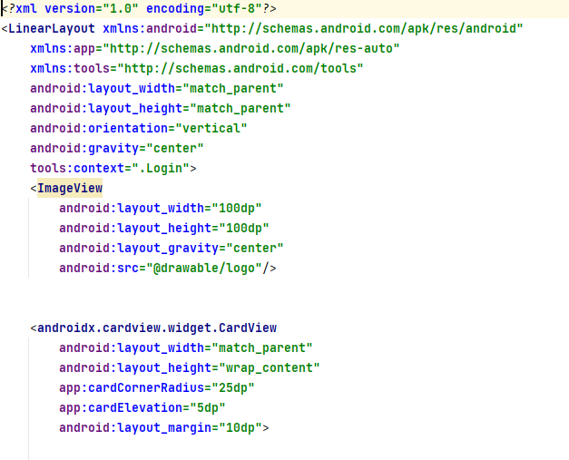
Implementation
LOGIN PAGE CODE

Slide 25
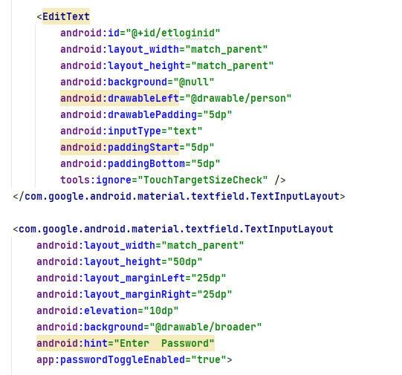
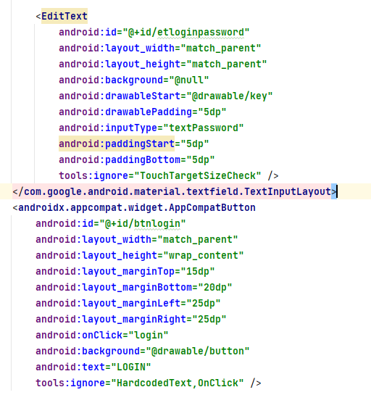
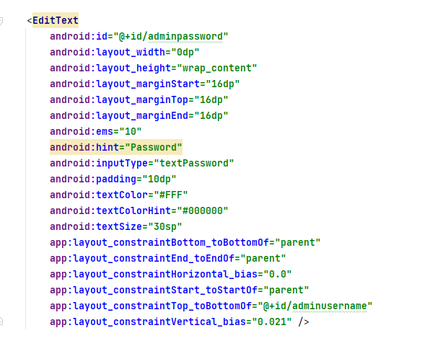
Implementation

Slide 26
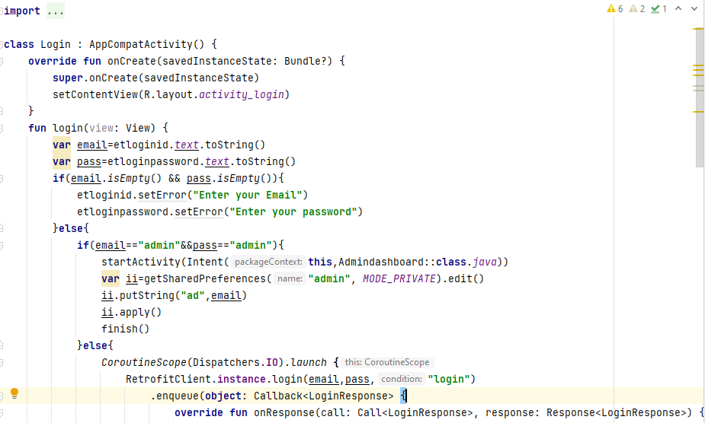
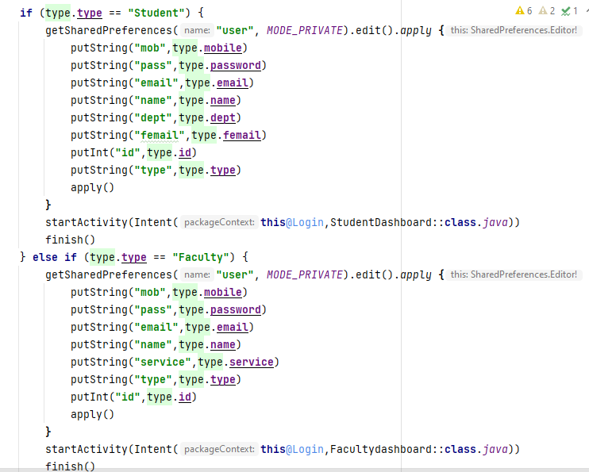
Implementation

Slide 27
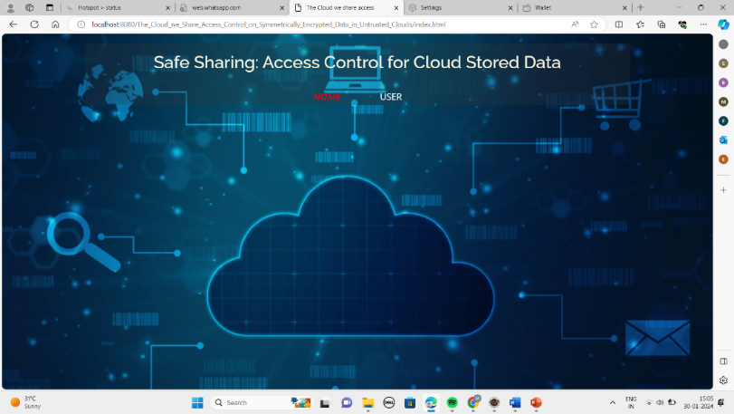
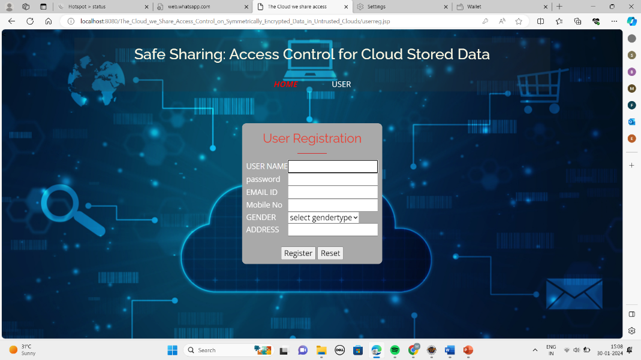
Implementation
Output Screens :

Slide 28
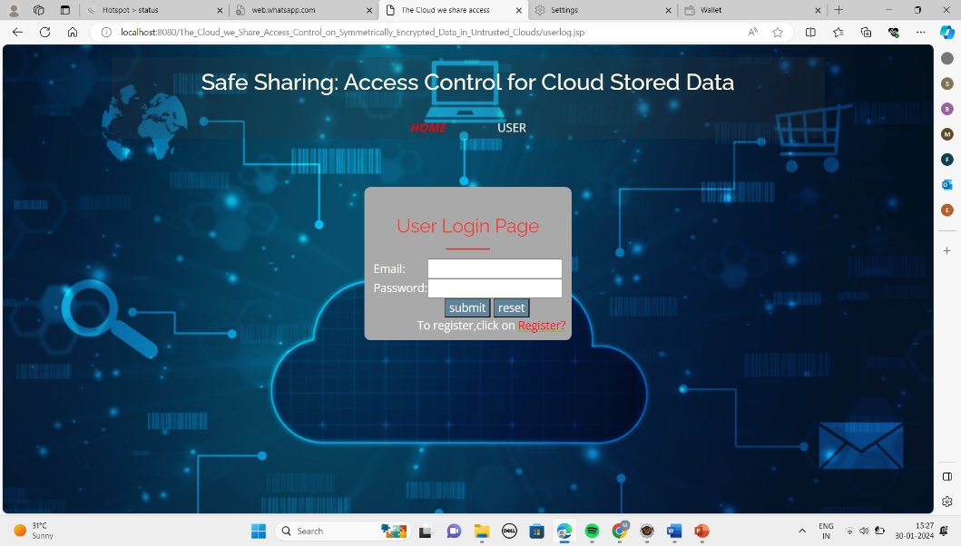
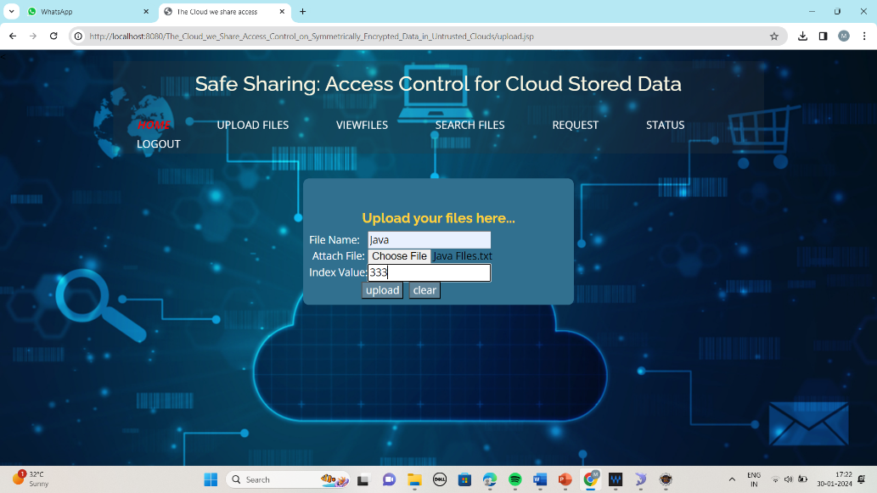
Implementation

Slide 29
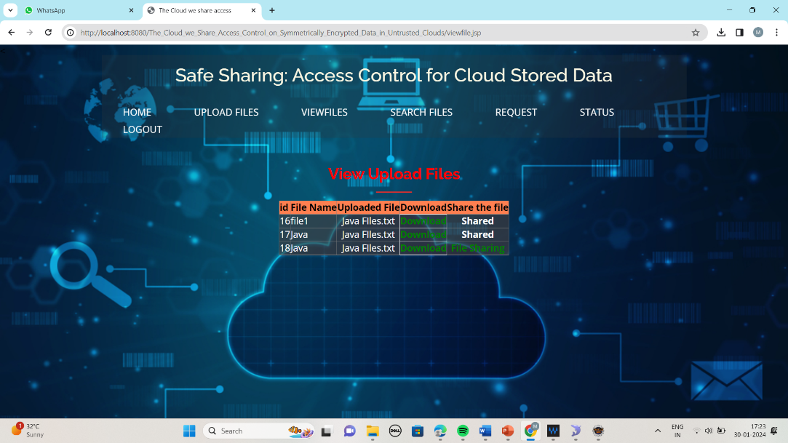
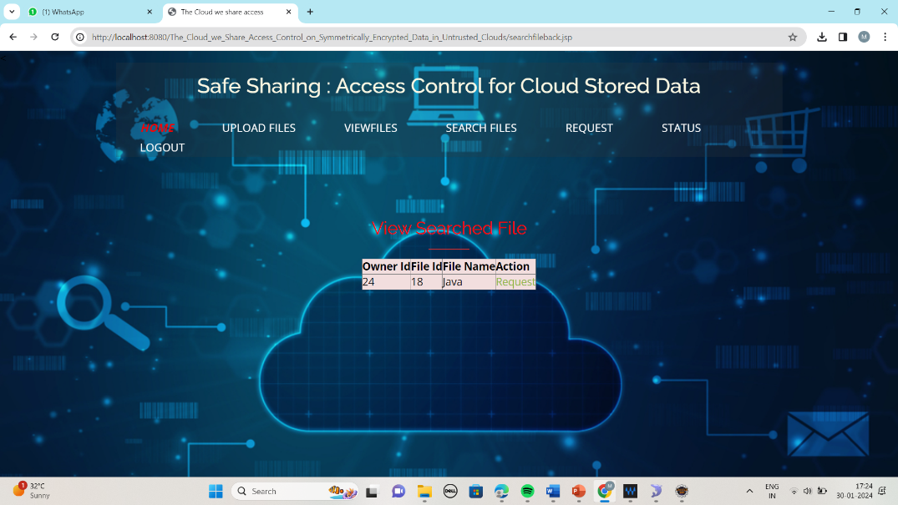
Implementation

Slide 30
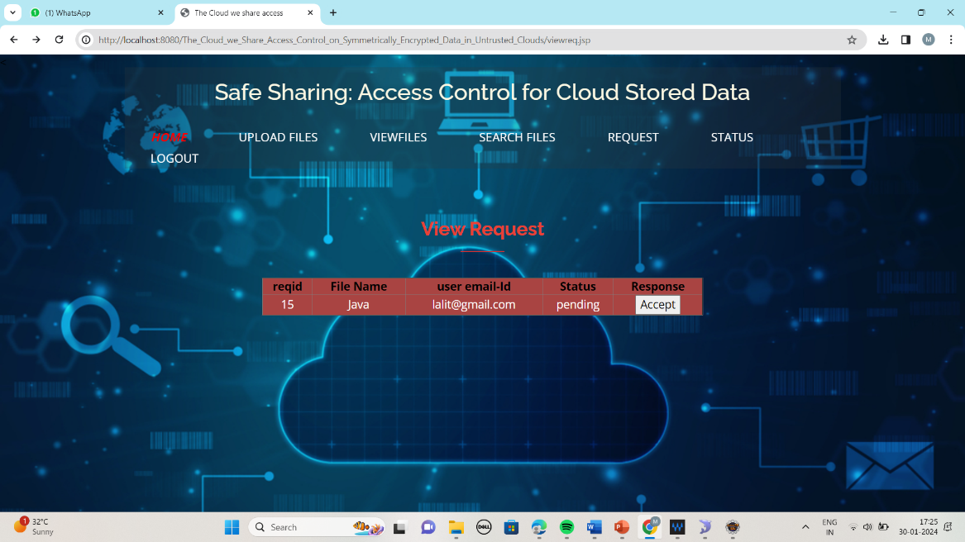
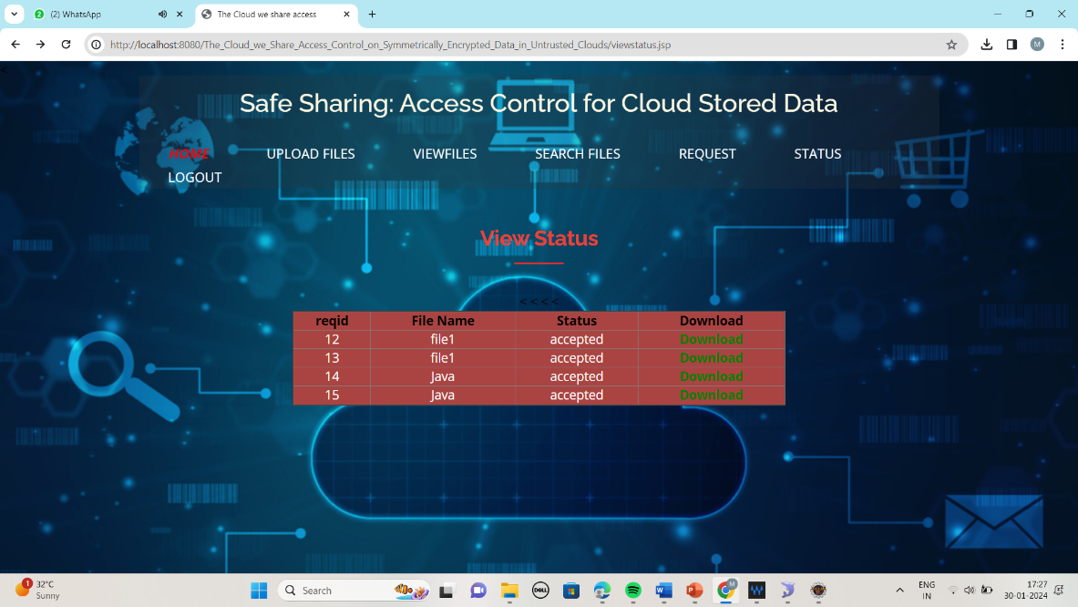
Implementation

Slide 31
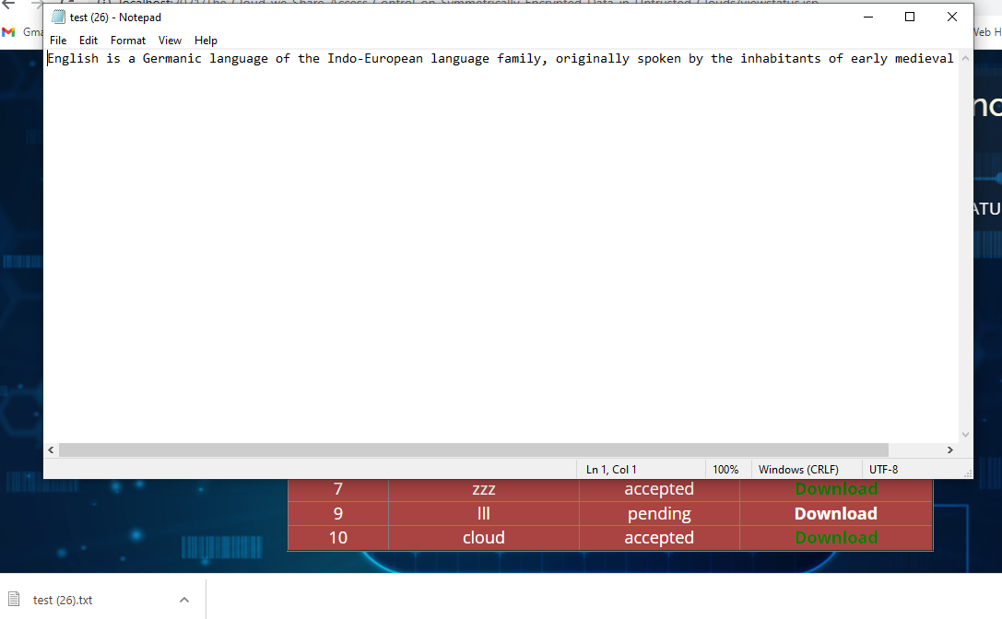
Implementation

Slide 32
Research Paper
Research Paper

Slide 33
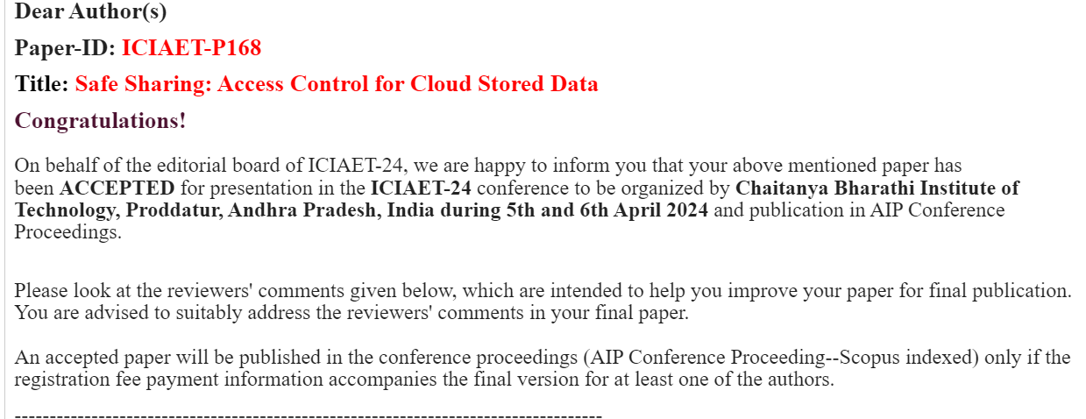
Acknowledgement

Slide 34
References
[1] S. Agrawal and M. Chase, ‘‘FAME: Fast attribute-based message encryption,’’ in Proc. ACM SIGSAC Conf. Comput. Commun. Secur., Oct. 2017, pp. 665–682.
[2] G. Amjad, S. Kamara, and T. Moataz, ‘‘Forward and backward private searchable encryption with SGX,’’ in Proc. 12th Eur. Workshop Syst. Secur. (EuroSec). New York, NY, USA: Association for Computing Machinery, 2019.
[3] A. Bakas and A. Michalas, ‘‘Modern family: A revocable hybrid encryption scheme based on attribute-based encryption, symmetric searchable encryption and SGX,’’ in Security and Privacy in Communication Networks, S. Chen, K.-K. R. Choo, X. Fu, W. Lou, and A. Mohaisen, Eds. Cham, Switzerland: Springer, 2019, pp. 472–486.

Slide 35
References
[4] A. Bakas and A. Michalas, ‘‘Multi-client symmetric searchable encryption with forward privacy,’’ Cryptol. ePrint Arch., Tampere Univ., Tampere, Finland, Tech. Rep. 2019/813, 2019. [Online]. Available: https://eprint.iacr.org/2019/813
[5] A. Bakas and A. Michalas, ‘‘Power range: Forward private multi-client symmetric searchable encryption with range queries support,’’ in Proc. IEEE Symp. Comput. Commun. (ISCC), Jul. 2020, pp. 1–7.

Slide 36
Thank You!!!

